Slide 1



IdealCare Limited Medical Agent Training
This training is for Agent use only and is not approved for the general public.
1

Slide 2

Training Objectives
Review the following details of the plan:
NationalWay Association
Non-Insured Benefits
Phone-A-Doc IDCare
IdealCare
MultiPlan PPO Network
Standard Life Limited Medical Benefits
Underwritten by Standard Life and Accident Insurance Company

Slide 3

AssociationBenefits

Slide 4


NationalWay Association
NationalWay is a not-for-profit member organization with a varied demographic of membership. Members from most states in the nation make up the population base of the association. NationalWay members all share the same common challenges which includes access to information on healthcare, services, products, nutrition and general wellness.
The Association’s purpose is to educate and inform its members with information concerning their success in life and improving the health, wellness and lifestyles of each member’s daily lives.

Slide 5
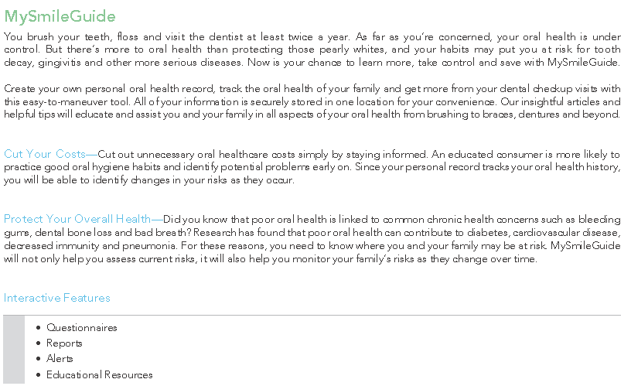

Association Benefits
These non-insured benefits included in Phone-A-Doc IDCare provide members with many valuable consumer discounts and services.

Slide 6
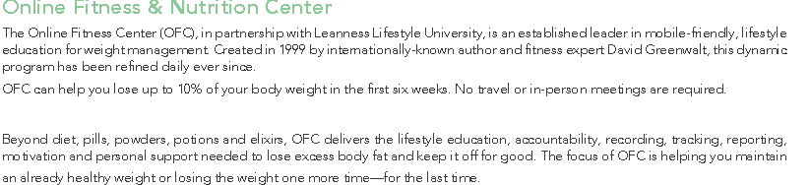
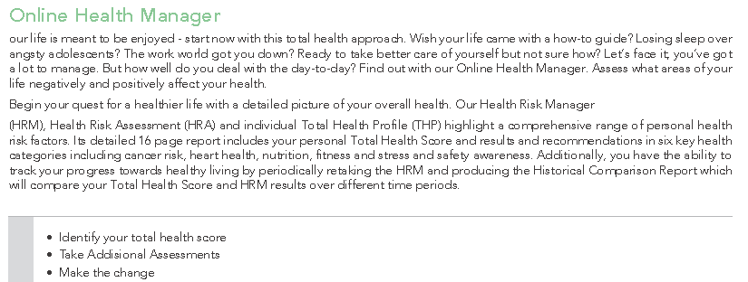
Association Benefits

Slide 7
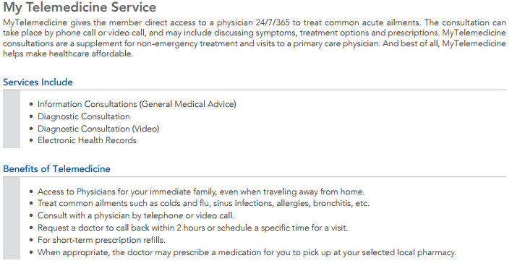
Association Benefits

Slide 8
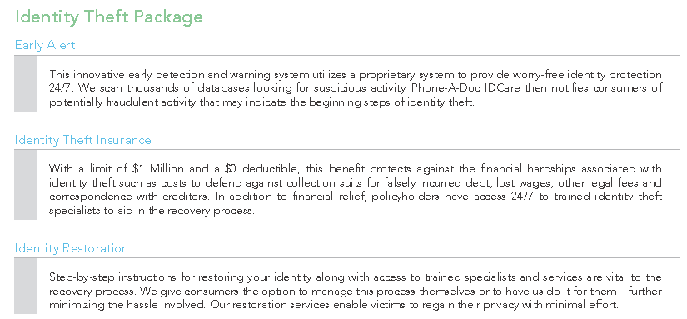
Association Benefits

Slide 9
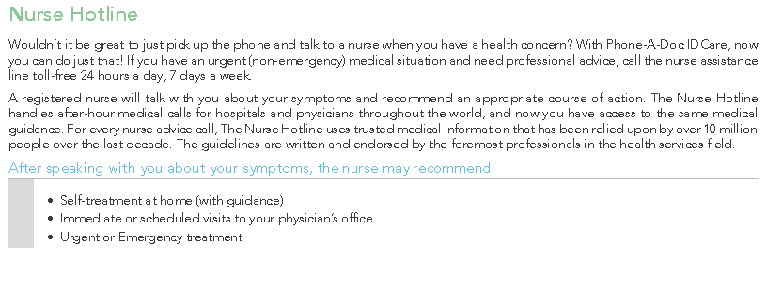
Association Benefits

Slide 10

Insured Benefits

Slide 11


Standard Life & Accident Insurance Company (“SLAICO”)
Standard Life and Accident was founded to provide clients in the individual market with realistic life and health products that solve their needs for financial security.
Today, Standard Life has expanded to provide protection for both large and small groups in the Worksite market offering competitive Accident, Cancer, Critical Illness, Group Term Life, Limited Medical and Short-Term Disability products.

Slide 12
Standard Life & Accident Insurance Company (“SLAICO”)
Financial Strength Ratings
Standard Life and Accident Insurance Company (“Standard Life”) has been evaluated and assigned the following ratings by nationally recognized, independent rating agencies. The ratings are current as of June 2017.
A.M. Best¹: A Standard & Poor's²: A-
Ratings reflect current independent opinions of the financial capacity of an insurance organization to meet the obligations of its insurance policies and contracts in accordance with their terms. They are based on comprehensive quantitative and qualitative evaluations of the company and its management strategy. The rating agencies do not provide ratings as a recommendation to purchase insurance or annuities. The ratings are not a warranty of an insurer's current or future ability to meet its contractual obligations.
Ratings may be changed, suspended, or withdrawn at any time. For the most current ratings view the full rating reports on Standard Life’s Internet site at www.slaico.com.
1 A.M. Best’s active company rating scale is: A++ (Superior), A+ (Superior), A (Excellent), A- (Excellent), B++ (Very Good), B+ (Very Good), B (Fair), B- (Fair), C++ (Marginal), C+ (Marginal), C (Weak), C- (Weak) and D (Poor).
2 Ratings from ‘AA’ to ‘CCC’ may be modified by the addition of a plus (+) or minus (-) sign to show relative standing within the major rating categories.
For a list of Standard & Poor’s active company rating scale visit www.standardandpoors.com.

Slide 13
MultiPlan PPO Network
MultiPlan is the nation’s oldest, largest and most comprehensive provider of independent medical cost management solutions, including PPO Networks. With a network of more than half a million healthcare professionals, over 4,700 hospitals and over 96,000 ancillary care facilities, plan participants will have access to a wide range of quality healthcare providers across the county. Plan participants can access and choose their Providers in order to take advantage of discounted prices through facilities and providers that are part of the MultiPlan network.
To locate a MultiPlan Provider visit www.multiplan.com - Search for a Doctor or Facility - Locate the logo shown below on the “other logos” tab.

Slide 14
Idealcare Limited-Benefit Health Insurance
IdealCare Limited-Benefit Health Insurance—underwritten by Standard Life and Accident Insurance Company—can help make major medical coverage more affordable for the average person with a cost sharing plan.
Benefits can be used as first dollar coverage and can be applied towards paying a high deductible. These plans are good for young families worried about accidents and unexpected critical illnesses.
Limited-benefit health insurance plans are not ACA compliant and do not meet the qualifications to be considered Minimum Essential Coverage under the law.

Slide 15
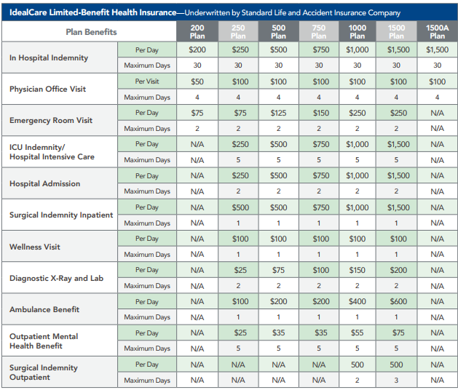
The pre-set dollar amounts listed above are what the insurance plan pays for specific health care services.

Slide 16
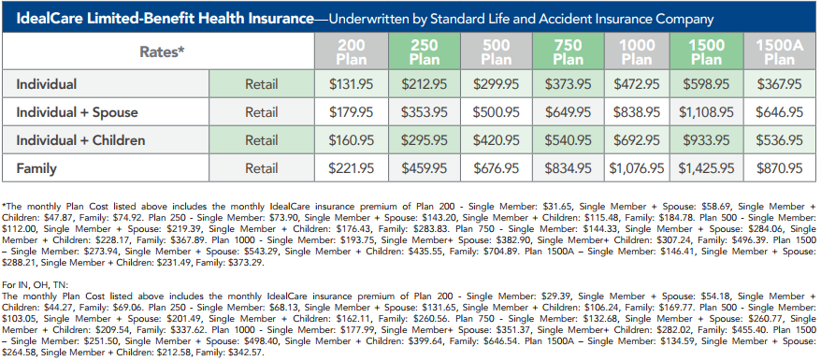

Slide 17
Limitations & Exclusions
Any services not specified in the Certificate of Coverage are not covered services under this Group Accident and Sickness Hospital Indemnity Plan. We will not pay benefits for treatment, services or supplies which: • Occur when the coverage is not in force; • Are not Medically Necessary; • Are not prescribed by a Physician as necessary to treat Sickness or injury, except for the Preventive Care Benefit; • Are Experimental/Investigative in nature, except as required by law; • Are received without charge or legal obligation to pay, except for Medicaid; or • Are provided by Immediate Family Are provided by Immediate Family.
Additional Limitations And Exclusions: Except as specifically provided for in this coverage or any attached Riders, We will not pay benefits for death, Sickness or injuries that are caused by: Dental Procedures—We will not pay benefits for Dental care or treatment except for such care or treatment necessitated by accidental injury to sound natural teeth within 12 months of the accident, and except for dental care or treatment necessary due to congenital disease or anomaly. Elective Procedures and Cosmetic Surgery—We will not pay benefits for cosmetic surgery, except for reconstructive surgery when such service is incidental to or follows surgery resulting from trauma, infection or other disease of the involved part and reconstructive surgery because of congenital disease or anomaly of a covered Dependent Child which has resulted in a functional defect. In the case of a Covered Person who is receiving benefits in connection with a mastectomy and who elects breast reconstruction in connection with such mastectomy, We will pay the Surgery Benefit, shown on the Certificate Schedule for: • All stages of reconstruction of the breast on which the mastectomy has been performed; • Surgery and reconstruction of the other breast to produce a symmetrical appearance; and • Prostheses and the treatment of physical complications at all stages of mastectomy, including lymphedemas. The maximum benefit paid for breast reconstruction surgery will be defined by the Surgery Benefit in the Certificate Schedule.
Felony or Illegal Occupation—We will not pay benefits for death, Sickness or injuries incurred during the commission or attempted commission of a felony, or to which a contributing cause was the Named Insured’s being engaged in an illegal occupation.

Slide 18
Limitations & Exclusions
Intoxication—We will not pay benefits for death or injuries that are contributed to in whole or in part from: • The Covered Person’s being intoxicated (defined as blood alcohol concentration equal to or in excess of the legal limit of the state or jurisdiction in which the injuries occurred). This applies whether or not the Covered Person is charged with any legal violation in connection with a loss; and there is no need to prove a loss was caused, contributed to, or resulted from the excessive blood alcohol concentration; or • The Covered Person’s: 1) voluntary use of illegal drugs; 2) the intentional taking of over the counter medication not in accordance with recommended dosage and warning instructions; or 3) intentional misuse of prescription drugs.
Pregnancy—We will not pay for medical treatment related to Pregnancy and childbirth except for those services required to treat Complications of Pregnancy, as defined in the Definitions section of this Certificate.
Suicide or Injuries Which Any Covered Person Intentionally Does to Him/Herself—We will not pay benefits for death, Sickness or injuries resulting from suicide, attempted suicide or intentionally self-inflicted injury. War or Act of War—We will not pay benefits for death, Sickness or injuries resulting from war or any act of war (whether declared or undeclared); participation in a riot or insurrection; or service in the Armed Forces or units auxiliary thereto. Worker’s Compensation – We will not pay benefits where such benefits would be provided under any State or Federal workers’ compensation, employers’ liability or occupational disease law.
Pre-Existing Condition Limitation—There is no coverage for, nor will we pay benefits for death, Sickness or injuries related to, a pre-existing condition for a continuous period of 12 months following the Certificate Effective Date of coverage under this coverage. This limitation applies to the following benefits: • Hospital Confinement Benefit • Hospital Admission Benefit • Hospital Intensive Care Unit Confinement Benefit • Emergency Room Benefit • Surgery Benefit • Doctor’s Office Visit Benefit • Diagnostic Tests Benefit • Ambulance Benefit • Mental Health Benefit. This limitation does not apply to: • Genetic information in the absence of a diagnosis of the condition related to such information; • A newborn child who is enrolled in the plan within 31 days after birth; nor to a child who is adopted or placed for adoption before attaining 26 years of age.

Slide 19
Eligibility
You are a member of NationalWay.
To be eligible to enroll in the coverage, an individual must:
Be a member of an eligible class as defined on the Certificate Schedule;
Be between 18 and 64 years of age at the time of enrollment;
Be a legal resident of the United States;
Not be in full-time service of the Armed Forces;
Not be eligible for Medicare;
Not receive disability or worker’s compensation benefits
Access to fulfillment materials at a1healthcare.com/members or by calling (800) 269-3563
This training is for Agent use only and is not approved for the general public.

Slide 20
Overview
An enrollment fee is collected by NationalWay Association with the first month's dues.
After enrolling, members receive:
Welcome email including Member ID and access to the Member Portal.
Hardcopy policy documents sent to the home address on file.
All enrollees are provided a 30-day right to examine the limited benefit policy with the option to cancel coverage back to the original effective date. If a member chooses to cancel their membership within the 30-day period, they will receive a full refund of monthly membership dues.
The 30-day period begins on the member’s effective date.
Access to fulfillment materials at a1healthcare.com/members or by calling (800) 269-3563
This training is for Agent use only and is not approved for the general public.

Slide 21
Contact Information
Member Services
csr@adroithealthgroup.com
(800) 269-3563
Agent Services
agentservices@adroithealthgroup.com
(800) 319-7061
Collections & Payments
pay@adroithealthgroup.com
(800) 391-1905
Commission Inquiries
commissions@adroithealthgroup.com

Slide 22
IdealCare Limited Medical Agent Training
This training is for Agent use only and is not approved for the general public.
22

